Slide 1
Java Project
Technology Stack and Demo Application Design

Slide 2
Technology Stack
Technology Stack:
React 18+ with HTML, CSS and JavaScript
Java 17
Spring Boot 3+
Spring Cloud(Distributed Tracing(Zipkin, Jaeger), API Gatway, Service Discovery, Circuit Breaker)
Spring Security
Spring Data JPA + Hibernate
RabbitMQ
PostgreSQL/MongoDB
Service-mesh(Optional)
Prometheous(Optional)
CI/CD Jenkins on AWS with Amazon ECR
AWS Cloud Platform + Kubernetes Deployment Env.

Slide 3
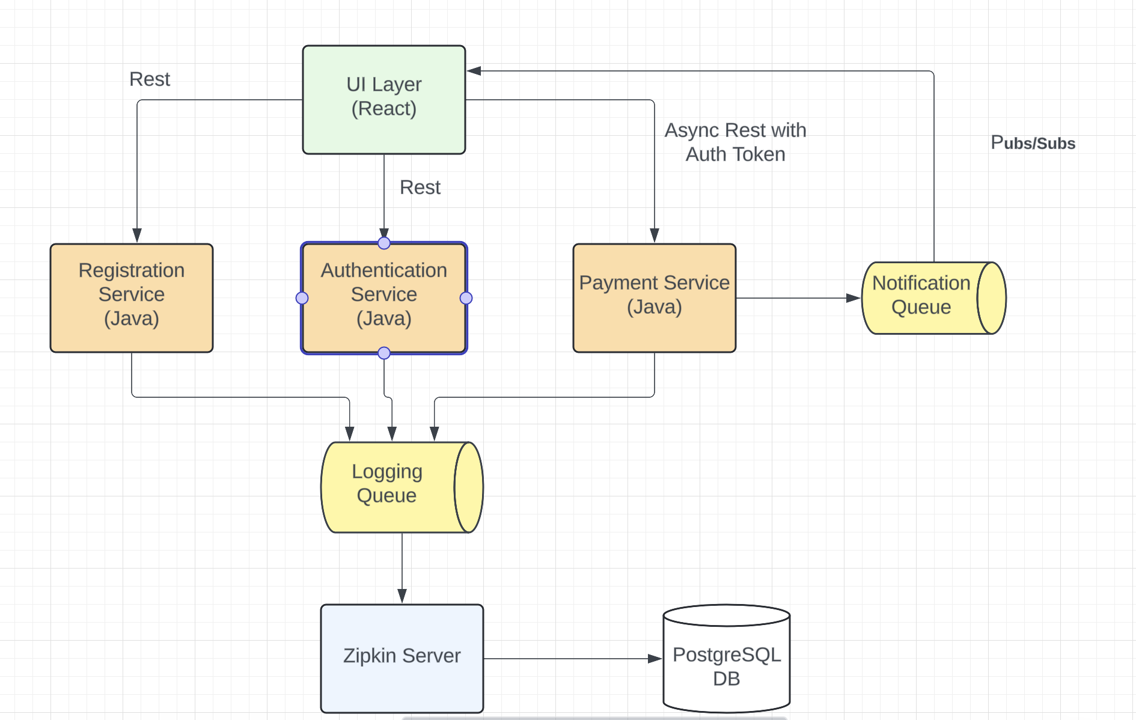
Demo Application Design

